Slide 1



COOKING WITH AI & ALSO COOKING WITH AI
Dan Placek
Principal Solutions Architect
Cloud & DevOps Practice Lead

Slide 2
PART 1:
THERE’S AN AI IN MY KITCHEN

Slide 3

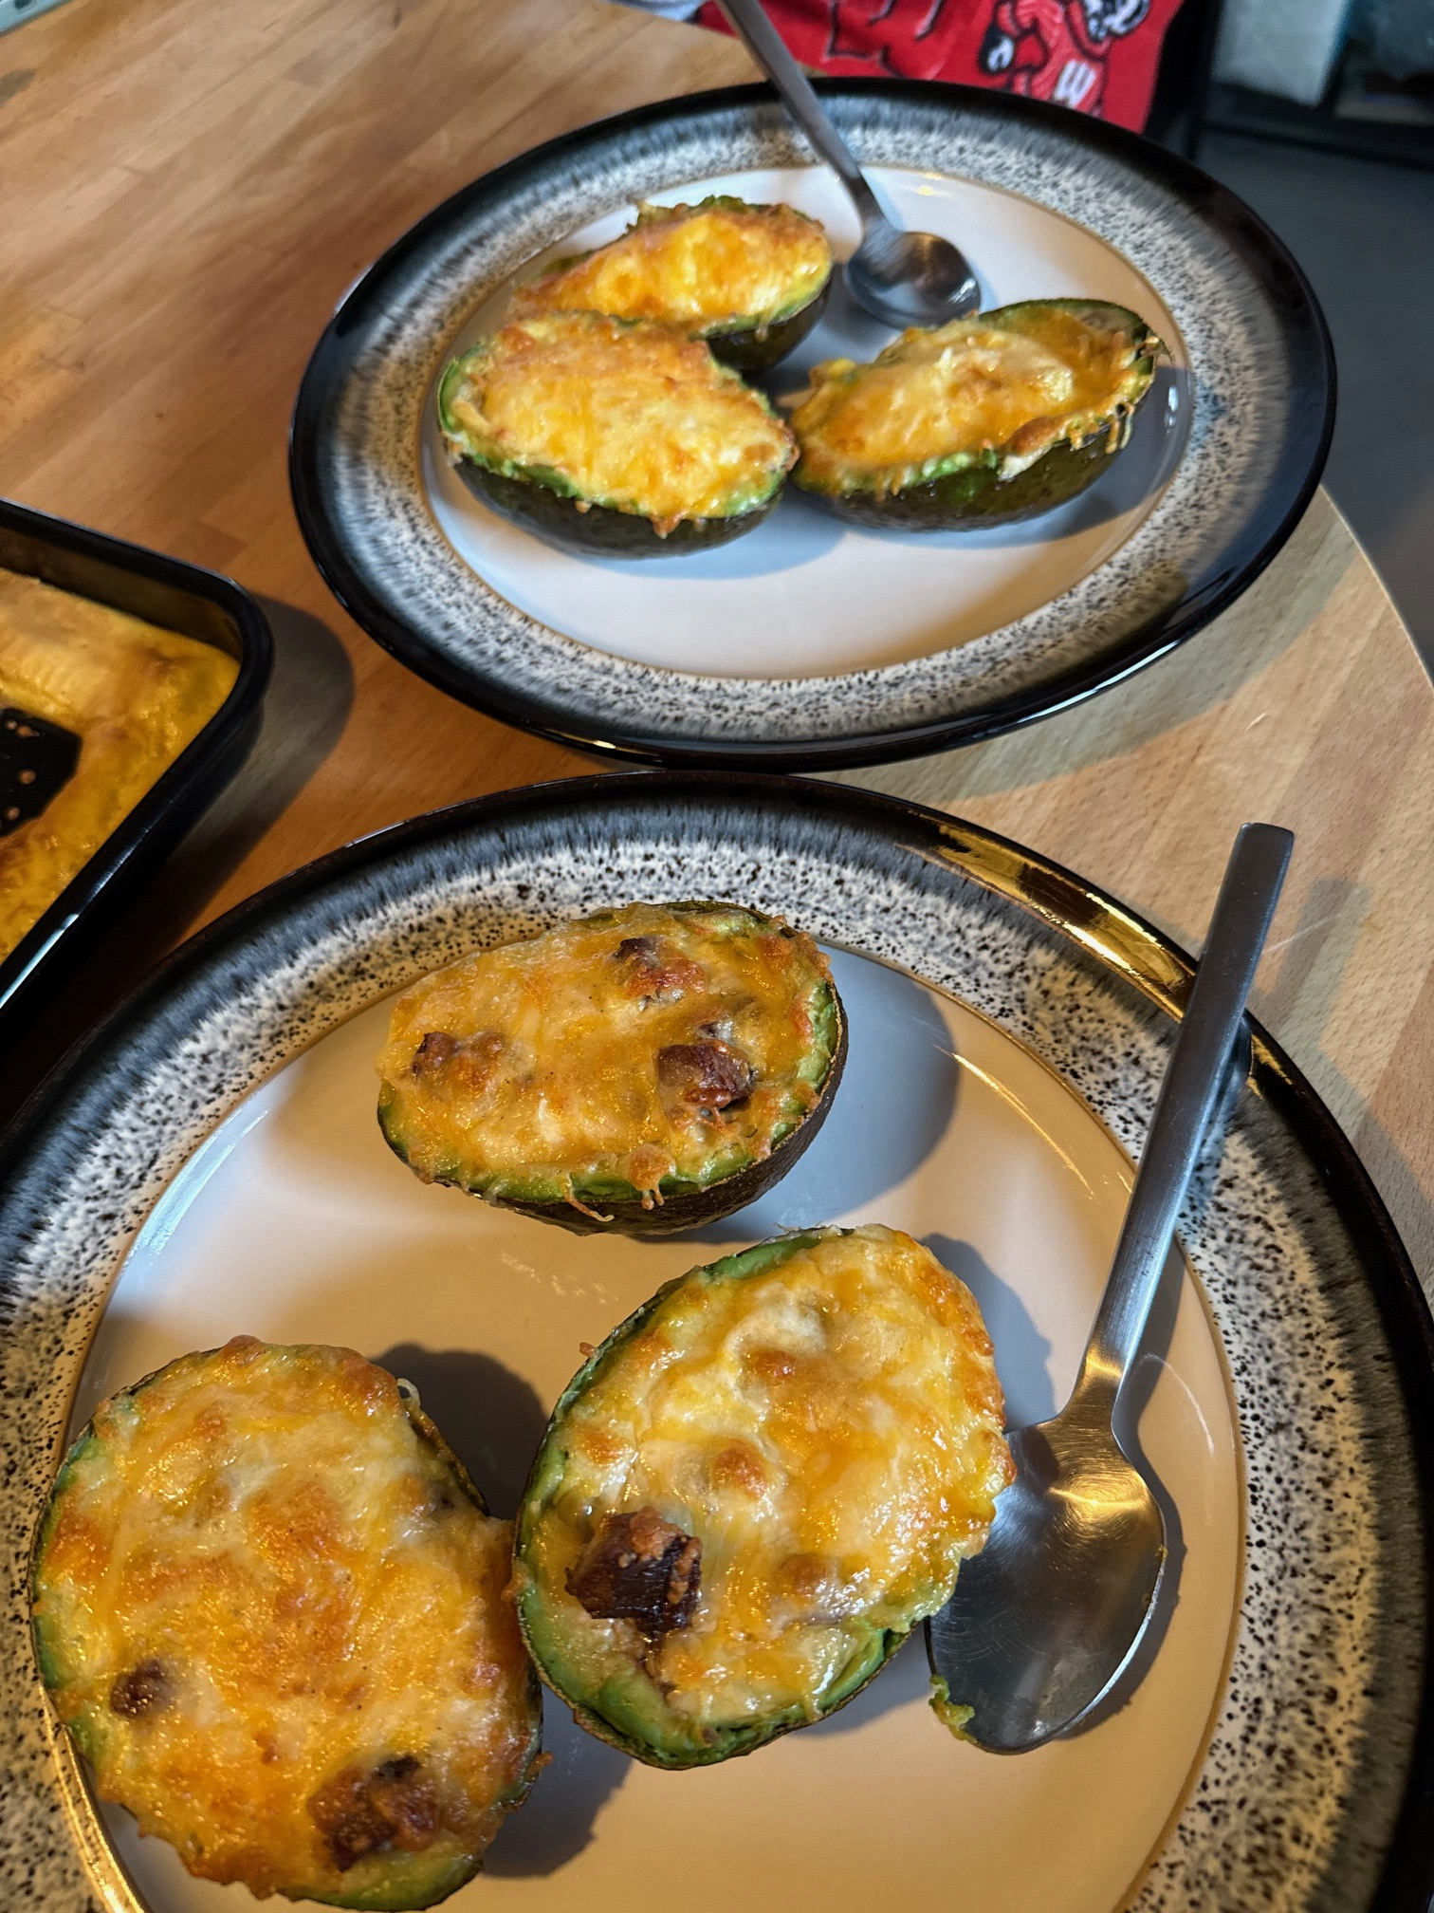

HAMBURGER BUNS
CREPES
STUFFED AVOCADOS

Slide 4

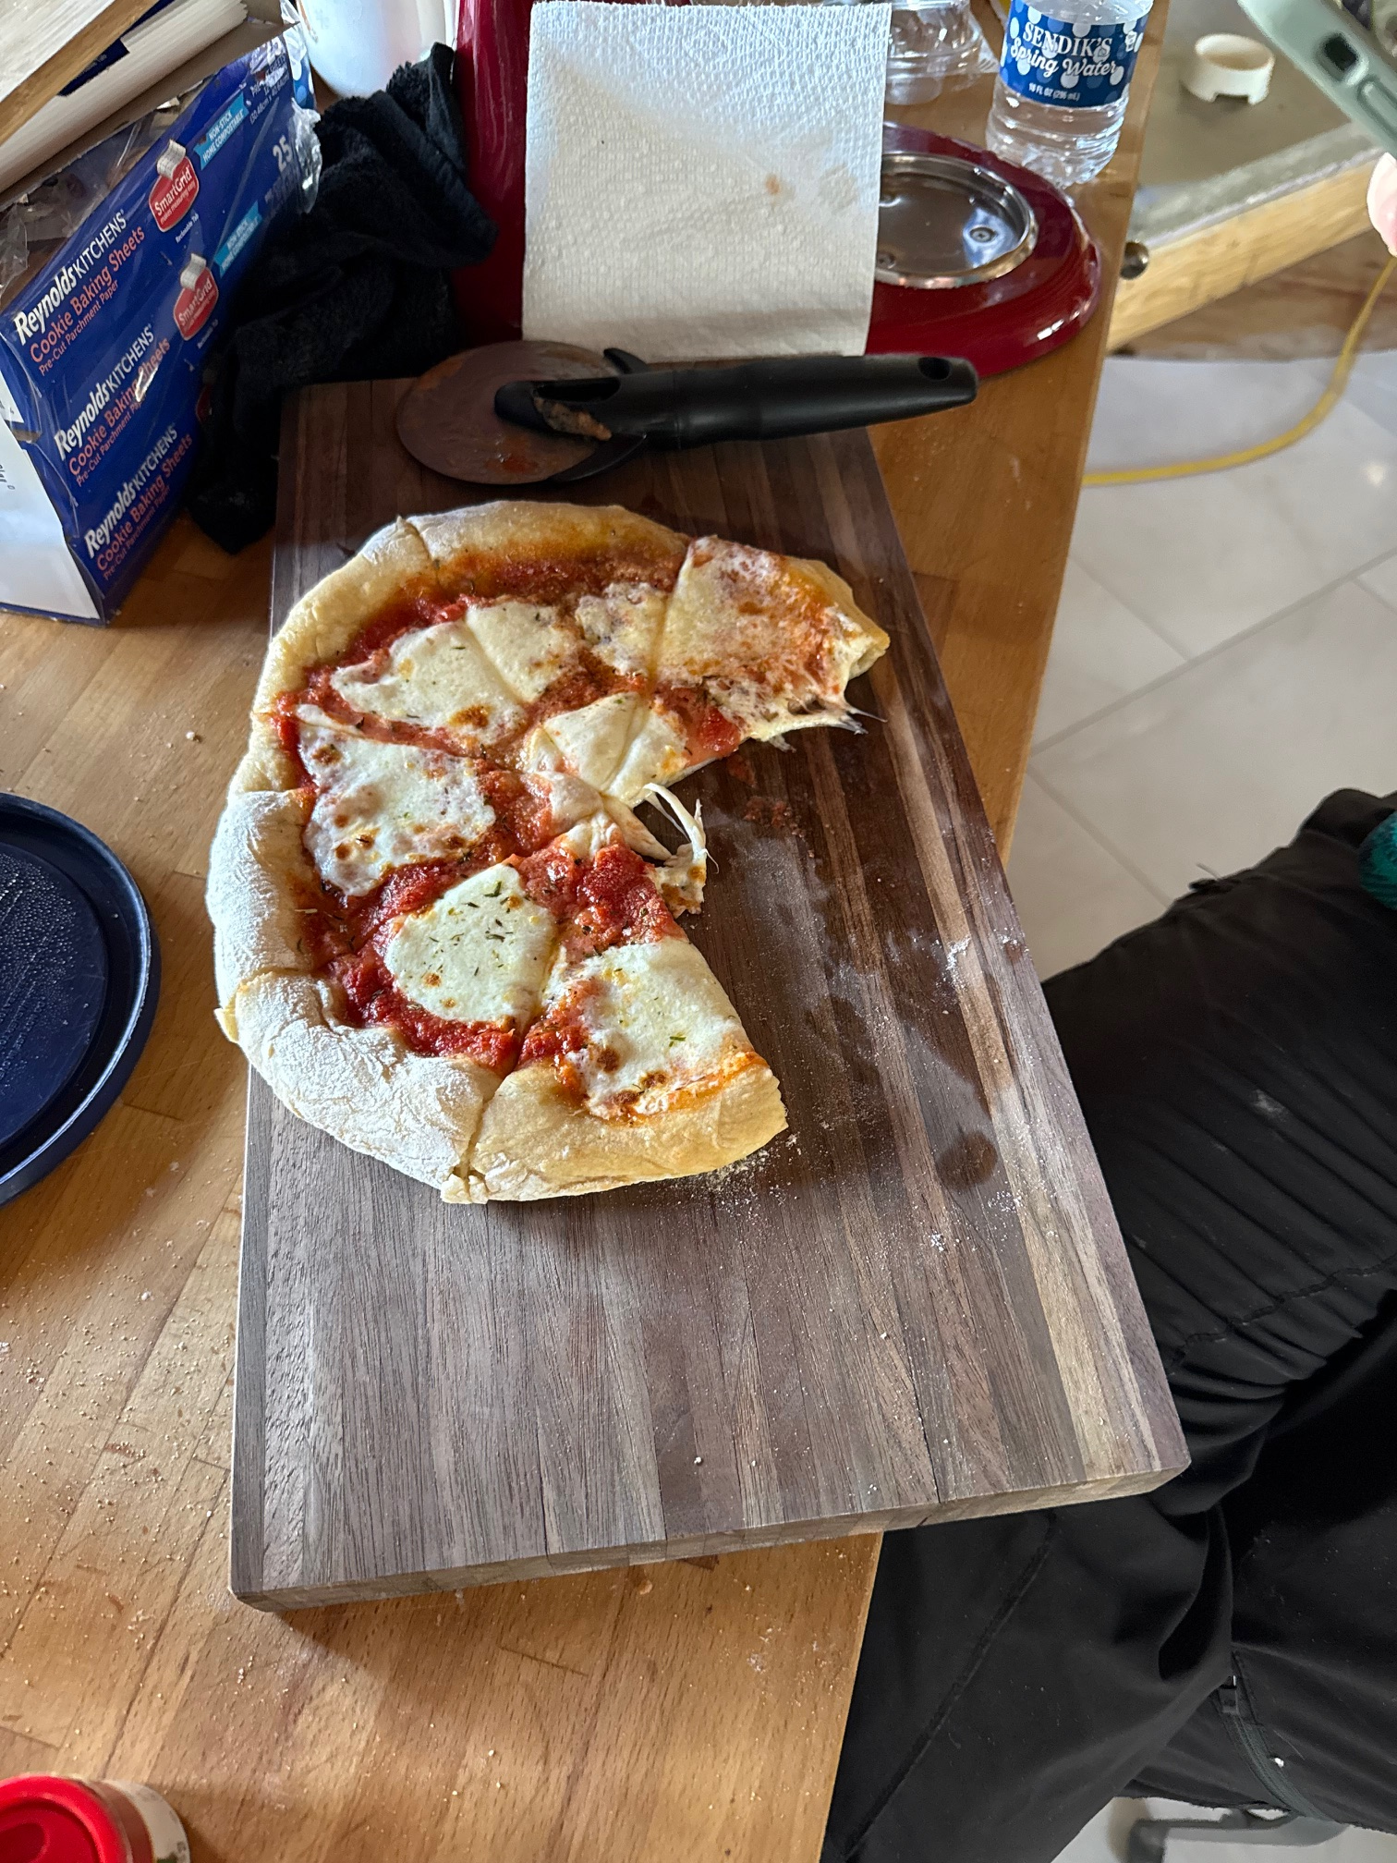
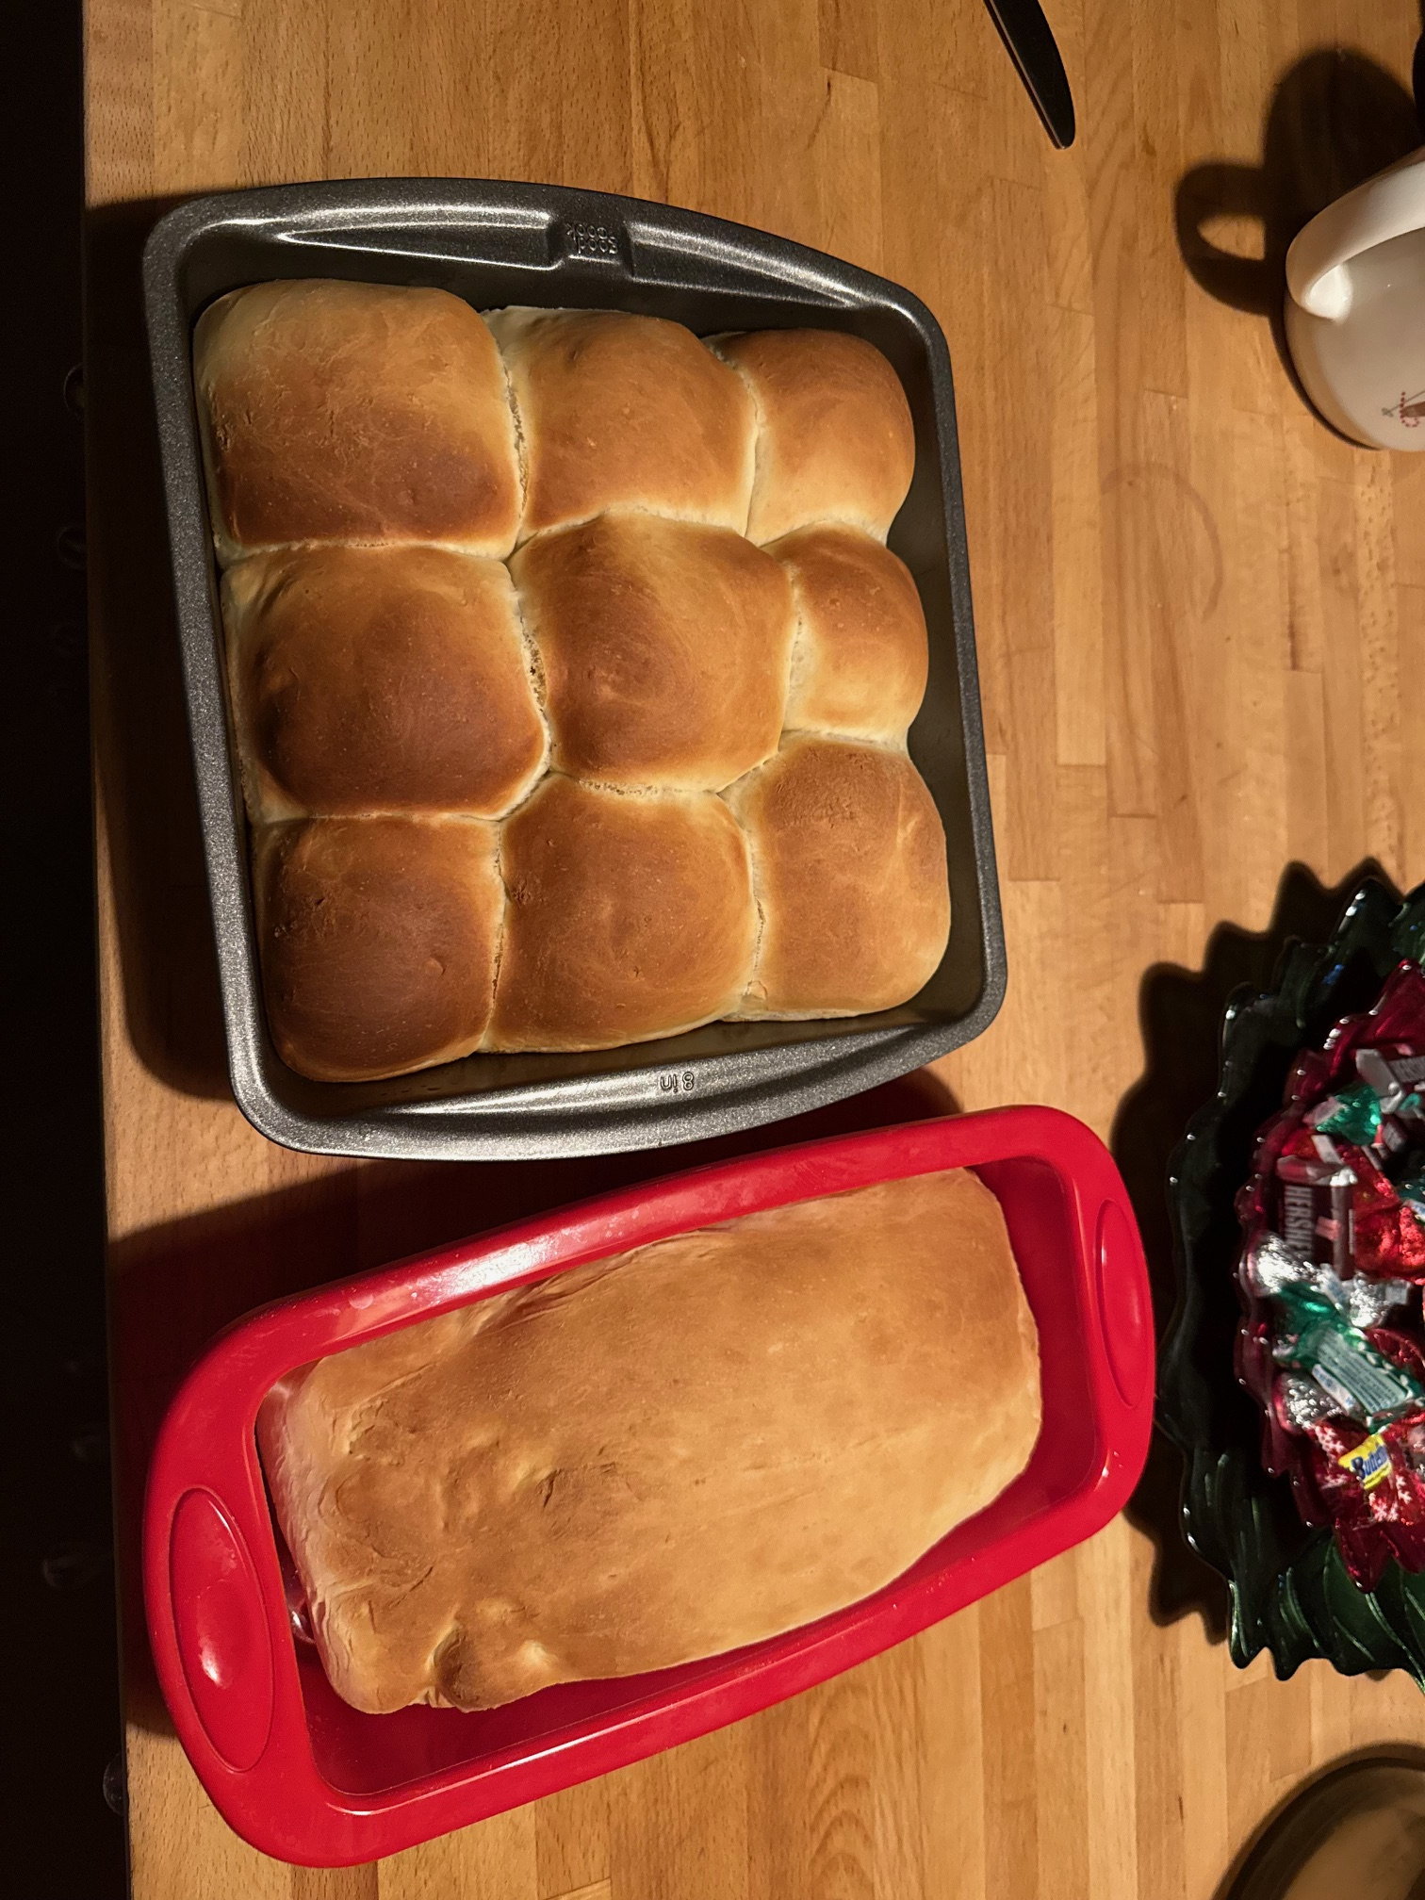
PIZZA
BUNS & SANDWICH BREAD
PULL-APART GARLIC BREAD

Slide 5


“DAN’S AI BREAD”
BANANA BREAD

Slide 6
How can I use AI while cooking?
Generating completely new recipes
Getting recipes based on the ingredients you already have
Tuning or modifying an existing recipe
Combining recipes
Getting help while cooking if something goes wrong (you can even use pictures!)
Finding out if it’s still safe to eat those leftovers you forgot about… (and then ignoring what the AI says and eating it anyway)
And more…

Slide 7
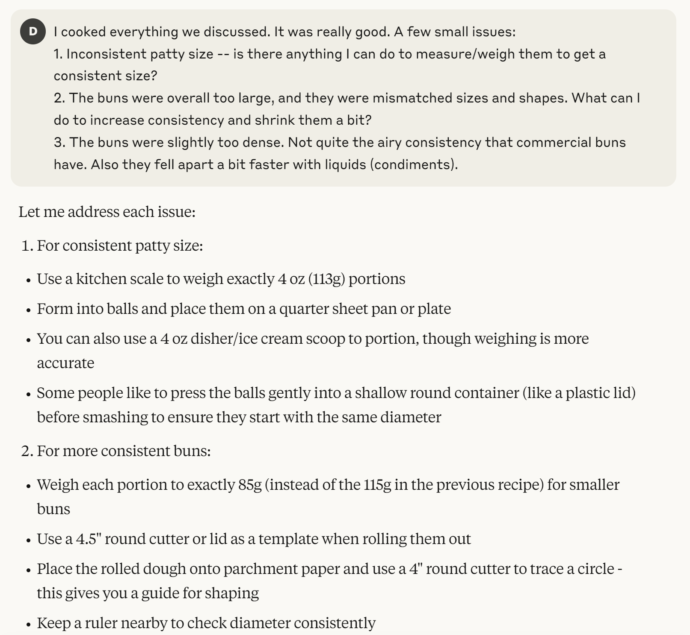
Example: Tuning a Recipe

Slide 8
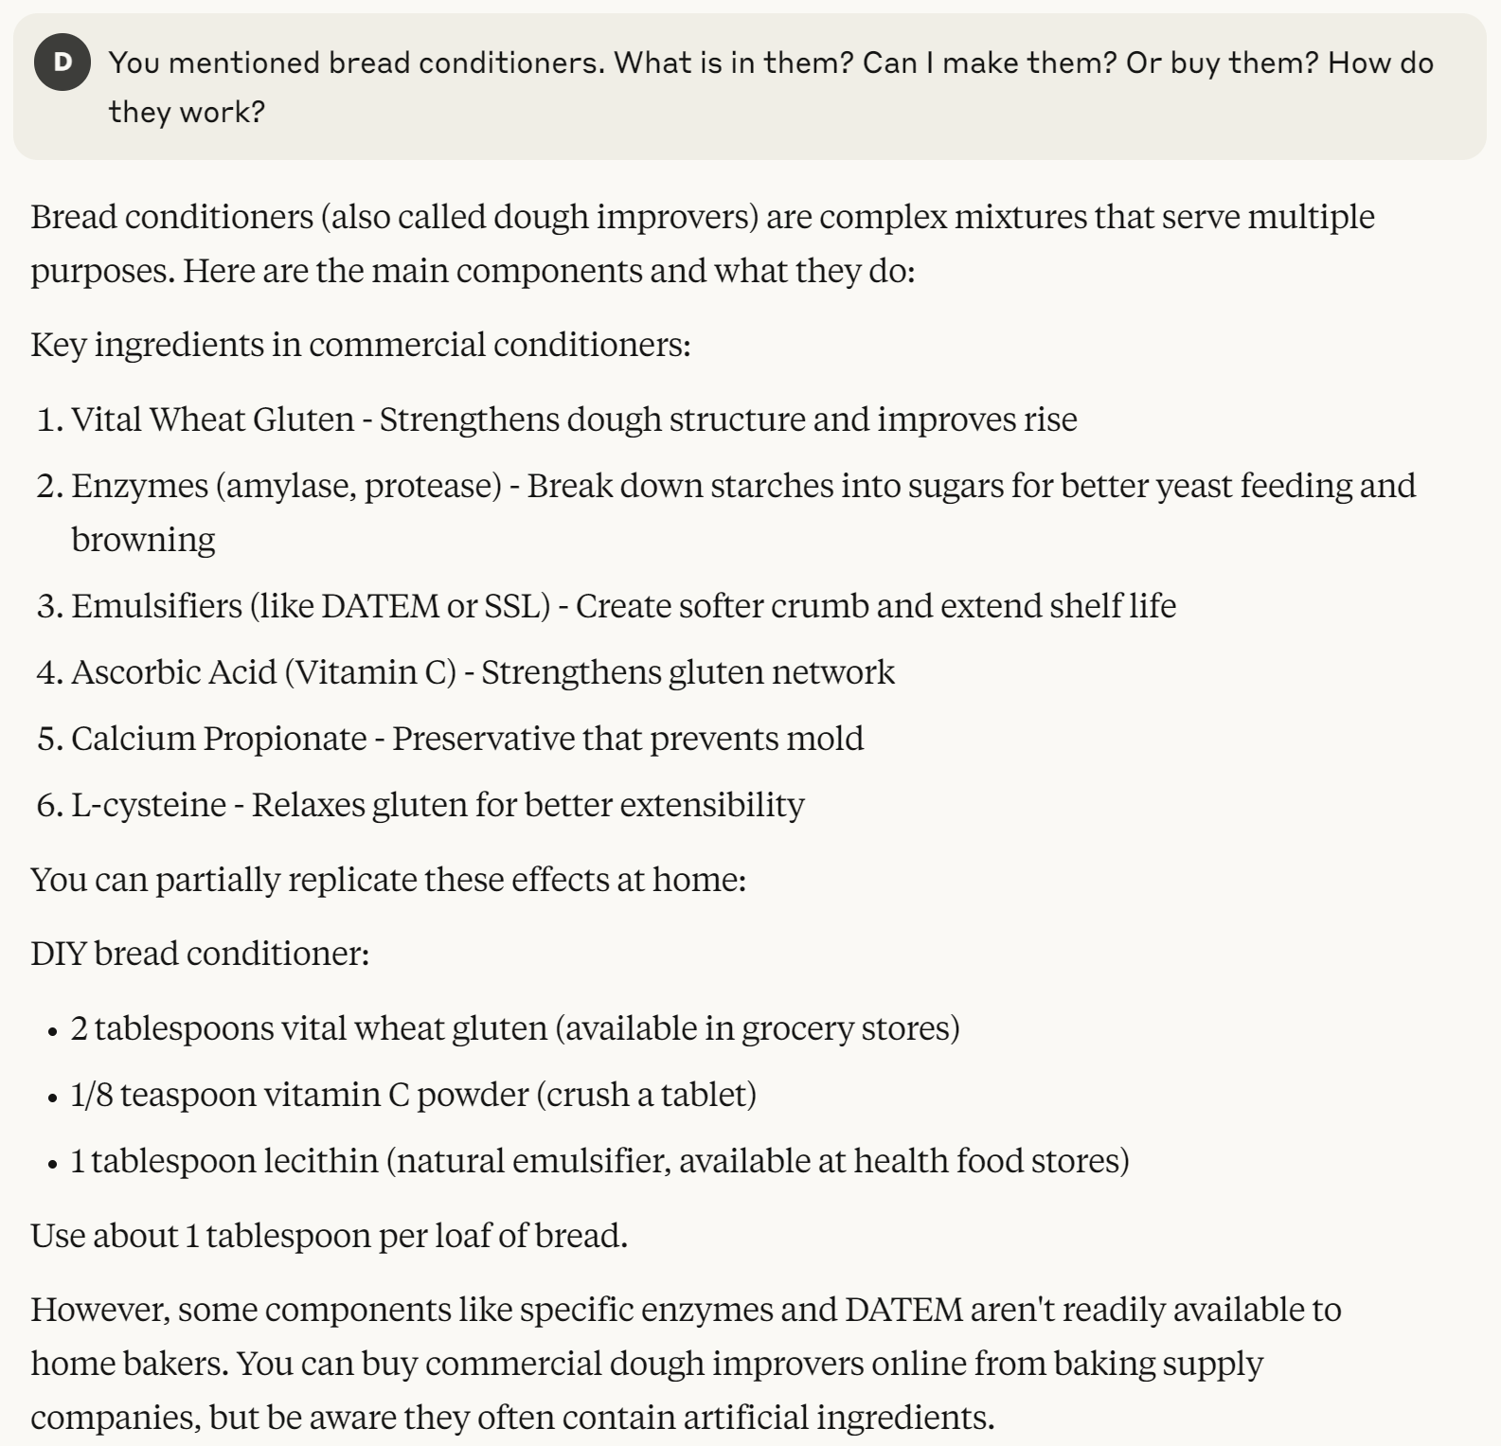
Example: Tuning a Recipe

Slide 9
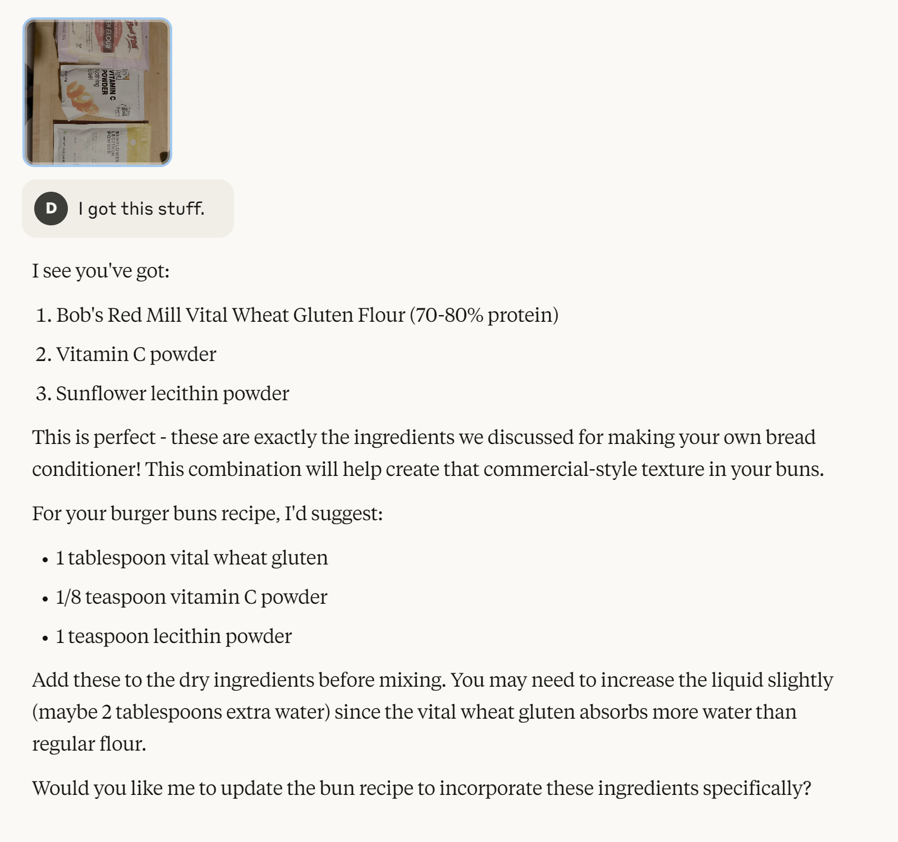
Example: Using Pictures

Slide 10
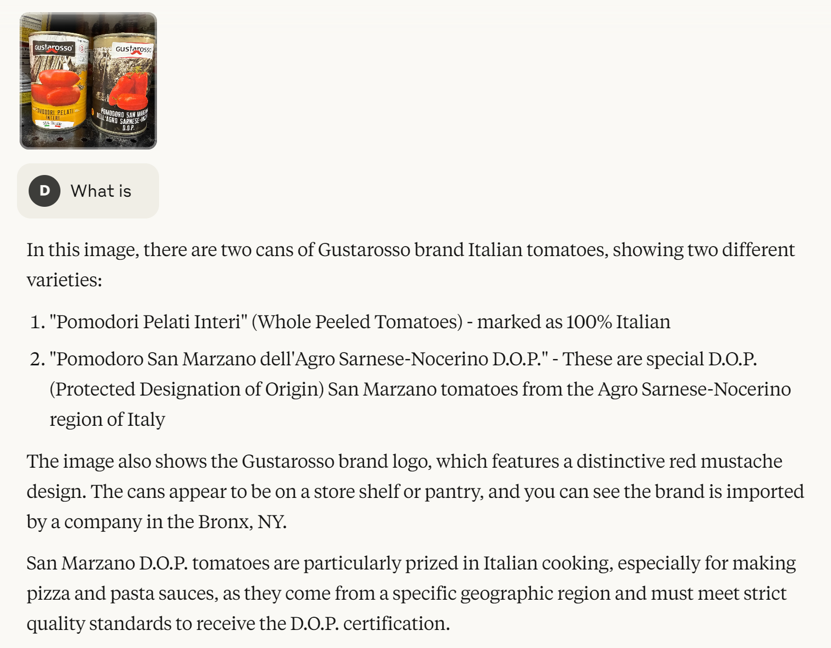
Example: Using Pictures (while shopping)

Slide 11
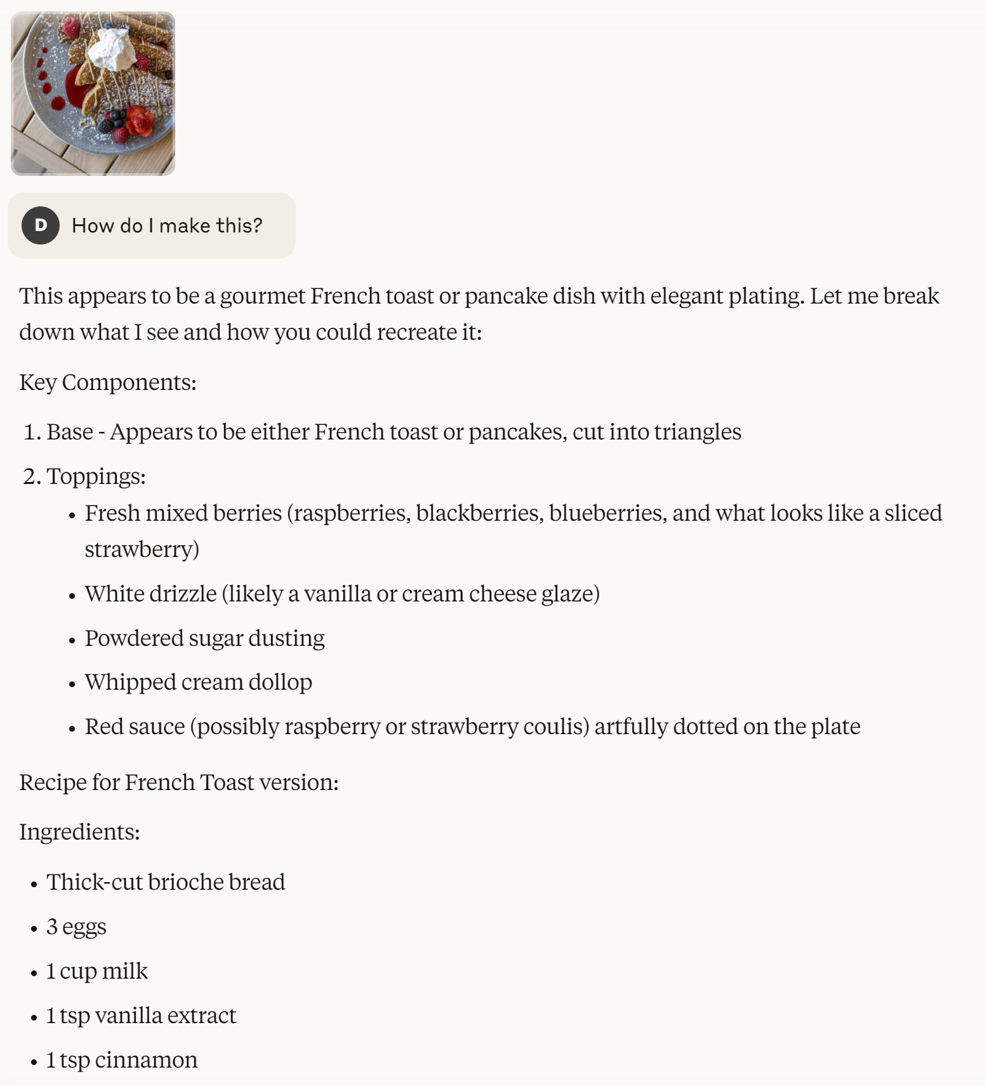
Example: Using Pictures (at a restaurant)
…

Slide 12
Some of my favorite recipes to get you started:
github.com/deep608v9/cooking-with-ai

Slide 13
PART 2:
COOKING UP SOME AUTOMATION
(WITH AI)

Slide 14
What IT tasks is AI good for today?
Generating and iterating on small automation code bases (Python, Go, PS, etc.)
Answering technical questions (that exist in public docs somewhere)
Providing troubleshooting assistance (sometimes)
Producing (first draft) documentation
Understanding code (applications, automations, or scripts) quickly

Slide 15
What IT tasks is AI bad for today?
Making changes in very large code bases
Answering questions about anything with non-public docs (there are some workarounds)
Troubleshooting really unusual problems

Slide 16




TOOL OPTIONS: DAN’S RECOMMENDATIONS

Slide 17


Cline Architecture
API Connection
(Your Enterprise Tenant)
Anthropic - Claude 3.5
Google - Gemini 2.5 Pro
OpenAI - o3-mini

Slide 18
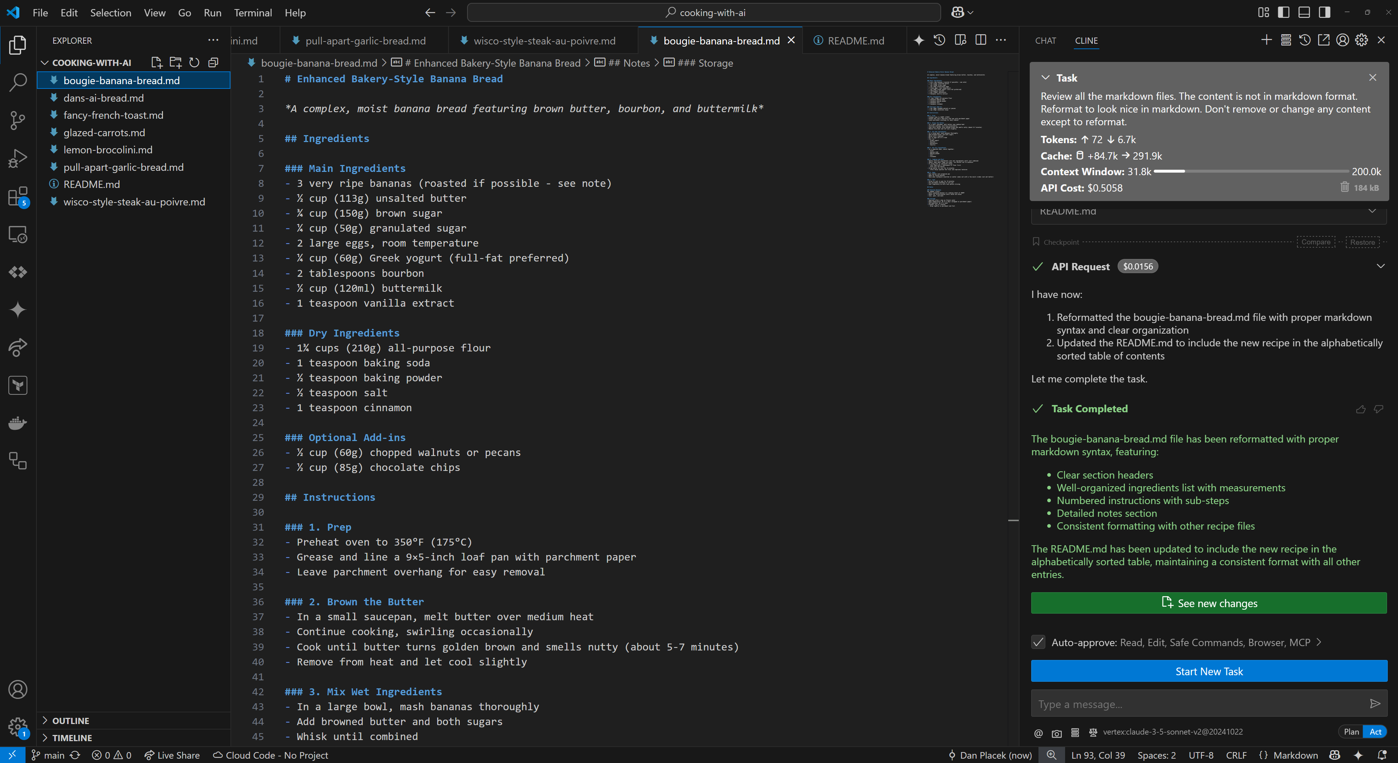

Slide 19
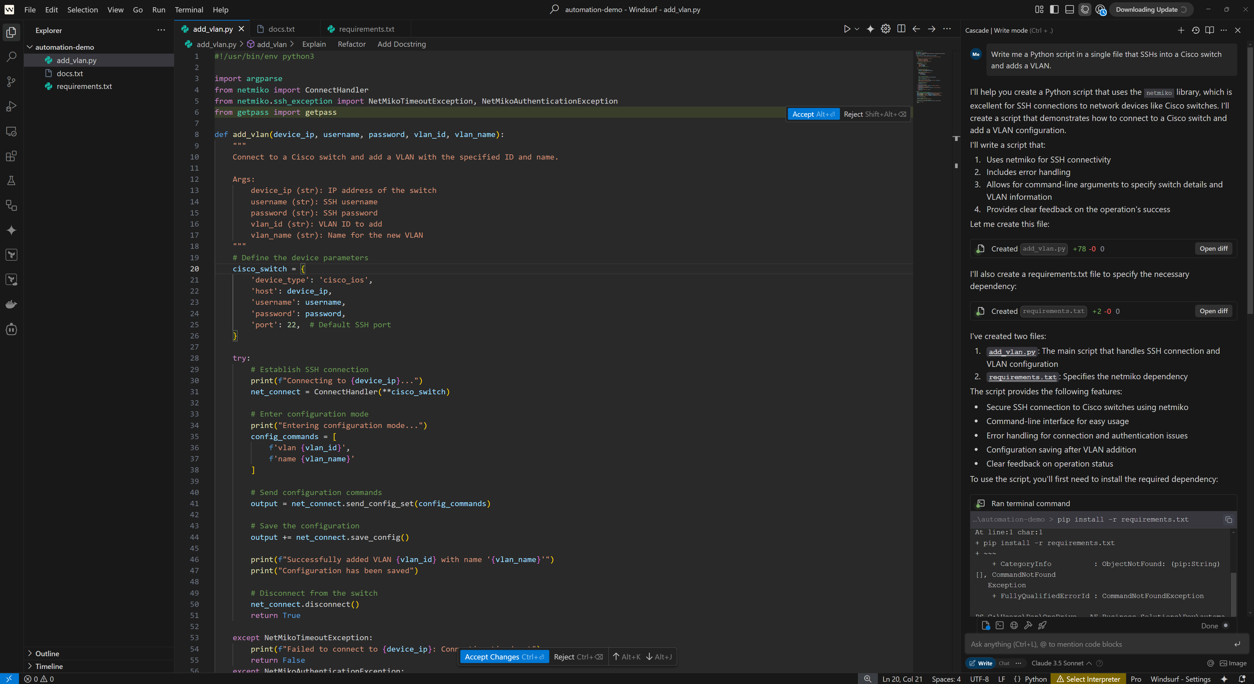

Slide 21
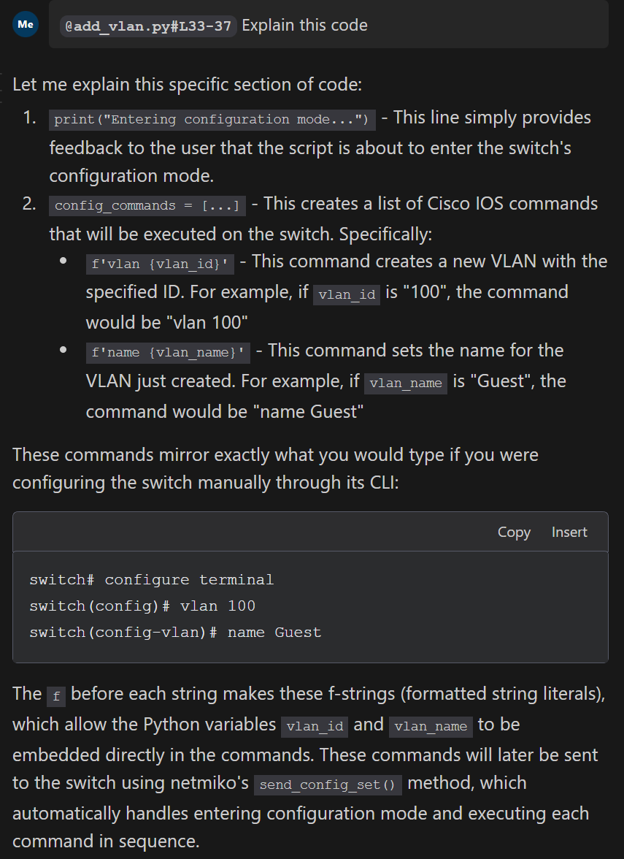

Slide 22
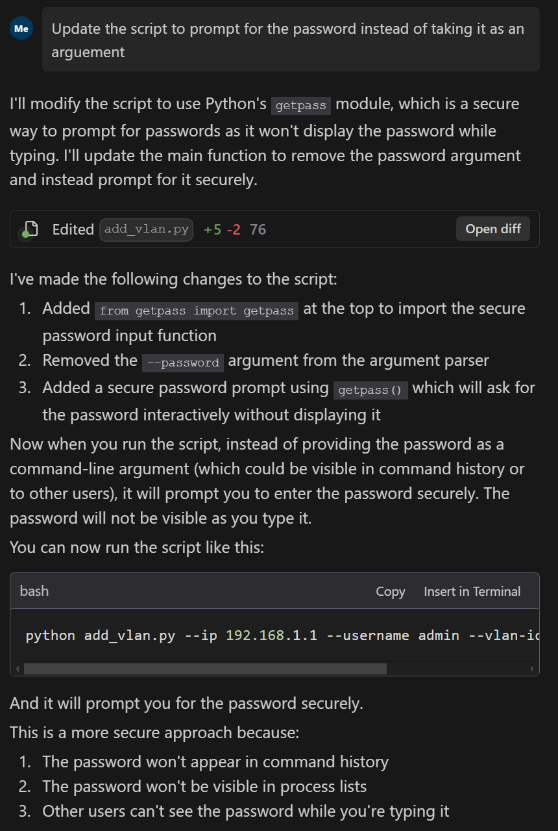

Slide 23
Prompt Engineering (for automation & other small software projects)
SPEC.md
# Cloudflare IP List Monitor
This Azure Function runs on a schedule and downloads the current Cloudflare Source IP List (https://www.cloudflare.com/ips-v4), stores the list in an Azure Storage Account, and sends a webhook alert if a new IP has been added.
Written in Python, using the requests library. Deployed with Terraform to Azure; a managed service identity is used for the Azure Function to Authenticate to the Azure Storage Account.

Slide 24
Prompt Engineering (for automation & other small software projects)
SPEC.md
# Cloudflare IP List Monitor
This Azure Function runs on a schedule and downloads the current Cloudflare Source IP List (https://www.cloudflare.com/ips-v4), stores the list in an Azure Storage Account, and sends a webhook alert if a new IP has been added.
Written in Python, using the requests library. Deployed with Terraform to Azure; a managed service identity is used for the Azure Function to Authenticate to the Azure Storage Account.
## Infrastructure as Code
Written in Terraform
Deploys Azure Function with MSI and Azure Storage Account
Any Resource Groups or other required resources are also deployed
The Azure Function is scheduled to run hourly
There should be an input parameter for a Webhook URL that the Azure Function will use (provided to the function as an Environment Variable)
The Azure Storage Account should have versioning enabled and be set for open public access

Slide 25
Prompt Engineering (for automation & other small software projects)
SPEC.md
# Cloudflare IP List Monitor
This Azure Function runs on a schedule and downloads the current Cloudflare Source IP List (https://www.cloudflare.com/ips-v4), stores the list in an Azure Storage Account, and sends a webhook alert if a new IP has been added.
Written in Python, using the requests library. Deployed with Terraform to Azure; a managed service identity is used for the Azure Function to Authenticate to the Azure Storage Account.
## Infrastructure as Code
Written in Terraform
Deploys Azure Function with MSI and Azure Storage Account
Any Resource Groups or other required resources are also deployed
The Azure Function is scheduled to run hourly
There should be an input parameter for a Webhook URL that the Azure Function will use (provided to the function as an Environment Variable)
The Azure Storage Account should have versioning enabled and be set for open public access
## Azure Function Details
Download latest IP list from Cloudflare
Check the Azure Storage Account to see if there is an existing IP list; if there is, download that as well
Compare the lists, call the webhook for each new entry
Replace the list in the Azure Storage Account with the new one if there are changes
Provide detailed debug output

Slide 26
Prompt Engineering (for automation & other small software projects)
SPEC.md
# Cloudflare IP List Monitor
This Azure Function runs on a schedule and downloads the current Cloudflare Source IP List (https://www.cloudflare.com/ips-v4), stores the list in an Azure Storage Account, and sends a webhook alert if a new IP has been added.
Written in Python, using the requests library. Deployed with Terraform to Azure; a managed service identity is used for the Azure Function to Authenticate to the Azure Storage Account.
## Infrastructure as Code
Written in Terraform
Deploys Azure Function with MSI and Azure Storage Account
Any Resource Groups or other required resources are also deployed
The Azure Function is scheduled to run hourly
There should be an input parameter for a Webhook URL that the Azure Function will use (provided to the function as an Environment Variable)
The Azure Storage Account should have versioning enabled and be set for open public access
## Azure Function Details
Download latest IP list from Cloudflare
Check the Azure Storage Account to see if there is an existing IP list; if there is, download that as well
Compare the lists, call the webhook for each new entry
Replace the list in the Azure Storage Account with the new one if there are changes
Provide detailed debug output
“Review @SPEC.md and create an implementation plan. Ask me if you have any questions or clarifications.”
…
<AI Response>
…
“Proceed with the implementation.”

Slide 27
QUESTIONS?
Dan Placek
Principal Solutions Architect
Cloud & DevOps Practice Lead
dan.placek@aebs.com
github.com/deep608v9/cooking-with-ai

